Slide 1




Laser-diamond interaction –
Modelling the device
damage during laser graphitization
Tzveta Apostolova¹, Stefano Lagomarsino^{2,3},
Silvio Sciortino^{2,3}, Chiara Corsi^{4,5}, Marco Bellini⁶
¹Institute for Nuclear Research and Nuclear Energy
²Istituto Nazionale di Fisica Nucleare
³ Dipartimento di Fisica, Università di Firenze
⁴ Dipartimento di Fisica, Università di Firenze
⁵LENS Florence
⁶INO-CNR Florence

Slide 2



Motivation
Laser engineering of diamond for writing conductive paths is an important subject of research for its application in radiation detection (3D detectors)[1,2].
[1] S. Lagomarsino et al Appl. Phys. Lett. 103, 233507 (2013)
[2] S. Lagomarsino , et al Diamond & Related Materials 43 (2014) 23–28
A deep insight of the process of laser graphitization of diamond is critical to tune at best the laser parameters and obtain low resistivity channels with minimum damage of the surrounding diamond lattice.
Simulate ultra-short laser-induced electronic excitation, absorption, and the subsequent relaxation processes in CVD monocrystalline diamond and compare to the results of experiment.

Slide 3
Why a 3D architecture for diamond trackers?
Since their very introduction (1997), 3D achitectures for silicon was intended to solve problems of radiation hardness in silicon detectors.
Lowering charge trapping probability in the bulk
Thus: increasing collection efficiency
+
+
+
+
+
+
-
-
-
-
-
-
(Nucl. Instr. and Meth. A 395 pp 328-343 (1997) )

Slide 4
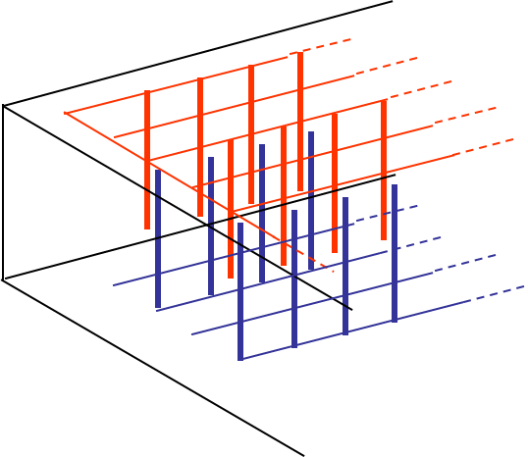
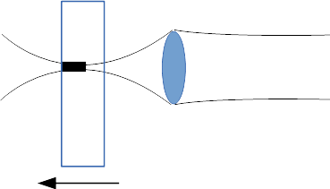
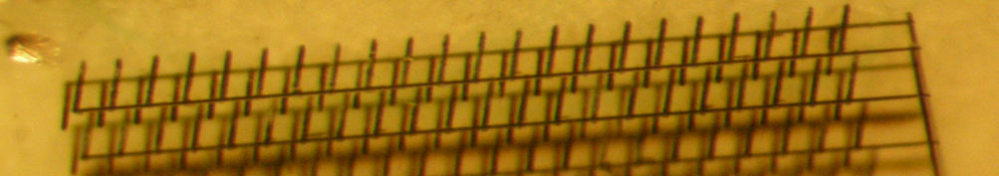
How it is made
Since 2009, a simple 3D pulsed laser technique has been made avalilable for microfabrication of 3D graphitic structures in the bulk Diamond (for optical applications)
T.V. Kononenko et al., Femtosecond laser microstructuring in the bulk of diamond, Diamond and Relat. Mater. 18 (2009) 196–199
This technique has been used by the collaborators to make conductive electrodes for 3D detectors.
Notes:
Since 2009, a simple 3D pulsed laser technique has been made avalilable for microfabrication of 3D graphitic structures in the bulk Diamond (for optical applications)

Slide 5
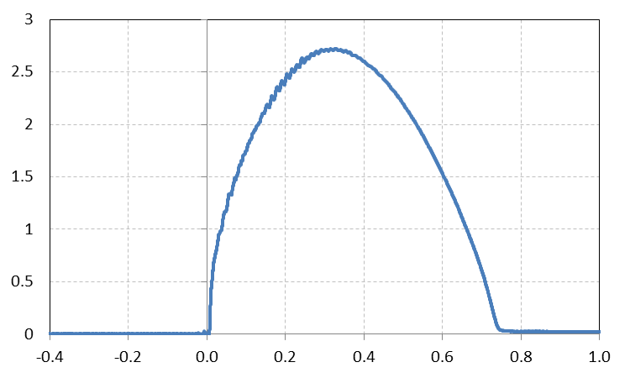
Our experimental approach:
The transient current technique (TCT) is used to measure laser induced current transients.
mA
μs
500 V

Slide 6
Our theoretical approach:
Theoretical modeling (Quantum kinetic formalism based on a Boltzmann-type equation including photo-excitation, free-carrier absorption, impact ionization, Auger recombination of electron-hole plasma, thermal exchange with the lattice is performed.
The transient conduction electron distribution functions, electron densities photo-generated and the average electron energies during the pumping fs-laser pulses are evaluated and damage criteria are given.

Slide 7
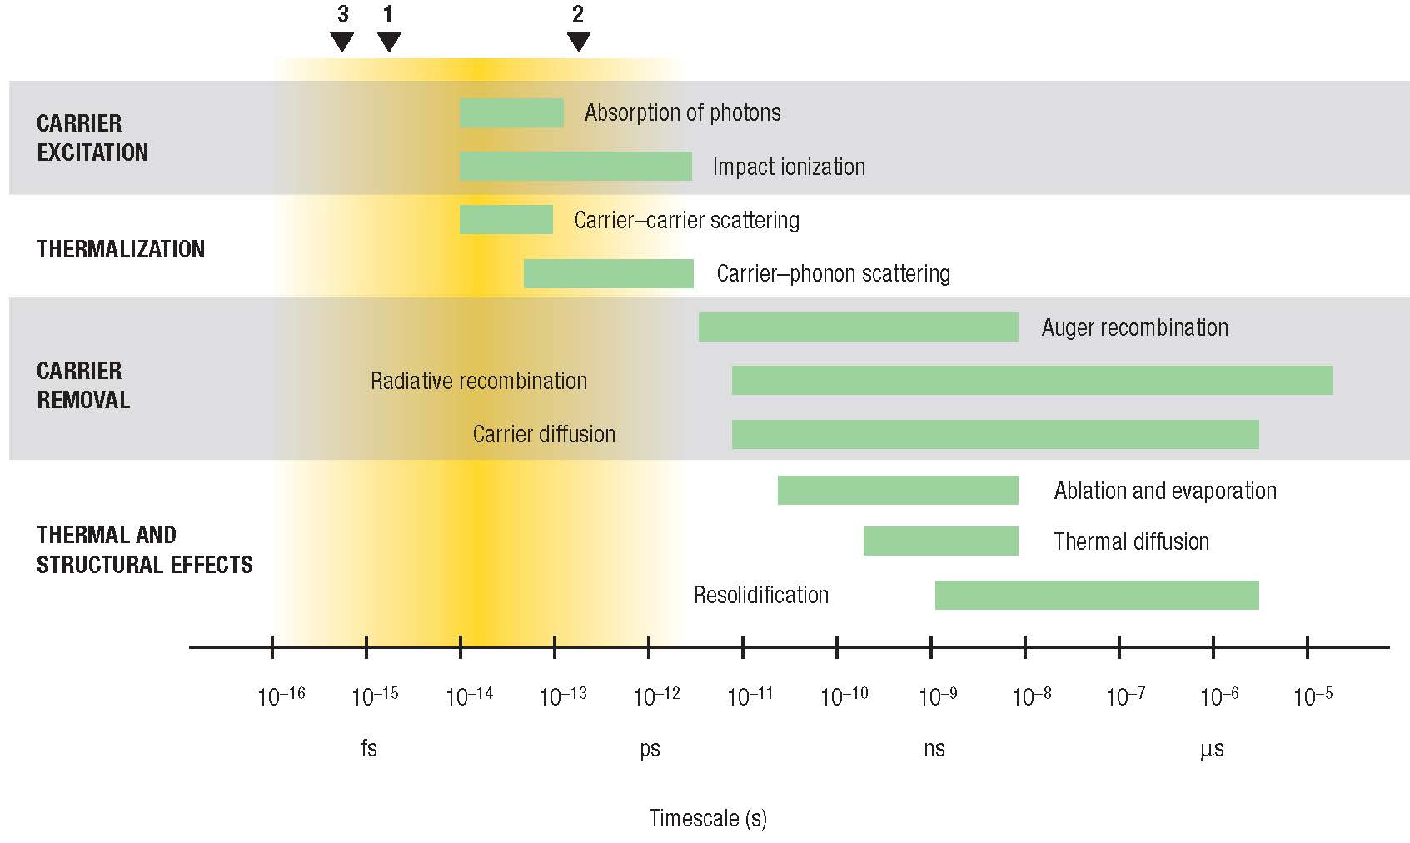
Timescales of various electron and lattice processes in laser-excited solids.
Inverse bremsstrahlung
Exciton formation/ non-radiative exciton decay
Original picture by S.K. Sundaram, Nature Materials 1 (4) 217-224 (2002) and edited for additional relevant processes
Notes:
1Timescales of various
electron and lattice processes in
laser-excited solids (after
ref. 10). Each green bar
represents an approximate range
of characteristic times over a
range of carrier densities from
1017 to 1022cm–3.The triangles at
the top show the current state-ofthe-
art in the generation of short
pulses of electromagnetic
radiation:1 5 fs (visible),2 120 fs
(X-ray),3 0.5 fs (far ultraviolet).

Slide 8
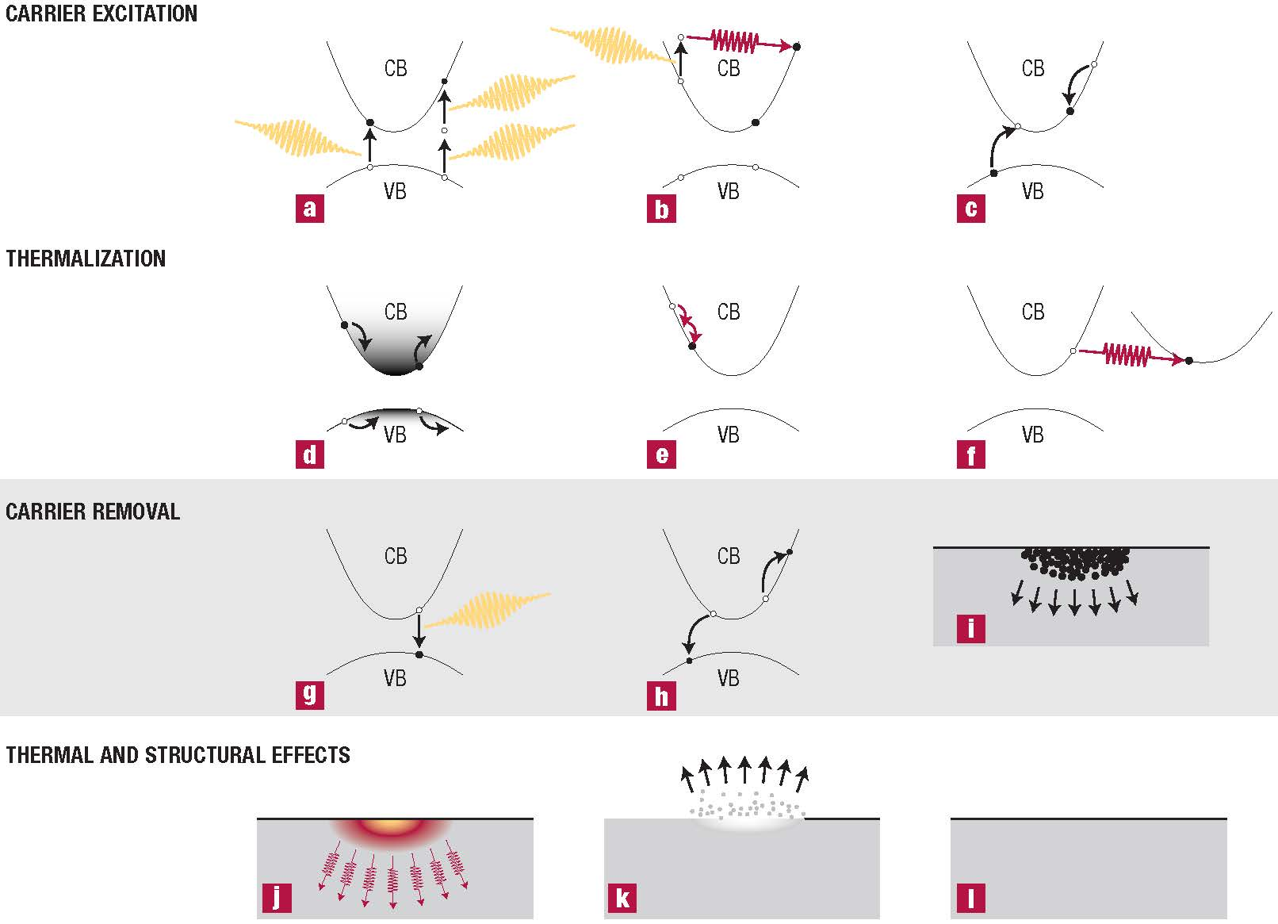
Mechanisms of absorption and deposition of energy and response of the material.
PI
II
IB
E-E
E-PHN
XF
XD
AR
Original picture by S.K. Sundaram, Nature Materials 1 (4) 217-224 (2002) eddited for the relevant processes

Slide 9
IB, II, E-E
Conduction band
AR, XF, XD,E-PHN
electron
Coupling to lattice
QM – Power density
Rate equations
Laser radiation
PI
Forbidden band
hole
Laser -PI, MPI
Valence band
CVD diamond

Slide 10
Boltzmann type scattering equation
Huang, Apostolova… PRB 71, 045204, 2005

Slide 11
Photo-ionization-Keldysh approach
L.V. Keldysh, JETP 20, 1965, Apostolova et al in press NIMA, 2014, Otobe et al, PHYSICAL REVIEW B 77, 165104, 2008

Slide 12
Exiton formation and decay
J. Zeller, et al, in: G.J. Exarhos, A.H. Guenther, N. Kaiser, K.L. Lewis, M.J. Soileau, C.J. Stolz (Eds.), 2003: pp. 515–526.

Slide 13
intravalley acoustic phonon
intervalley phonon
Huang, Apostolova… PRB 71, 045204, 2005,
B. K. Ridley, Quantum Processes in Semiconductors (Clarendon, 1999)

Slide 14
Electron-electron scattering
Impact ionization
Apostolova et al, in press, NIMA, 2014

Slide 15
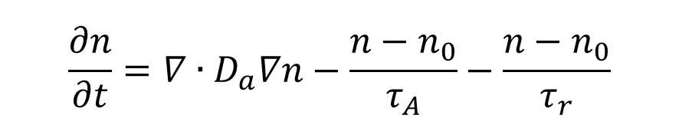
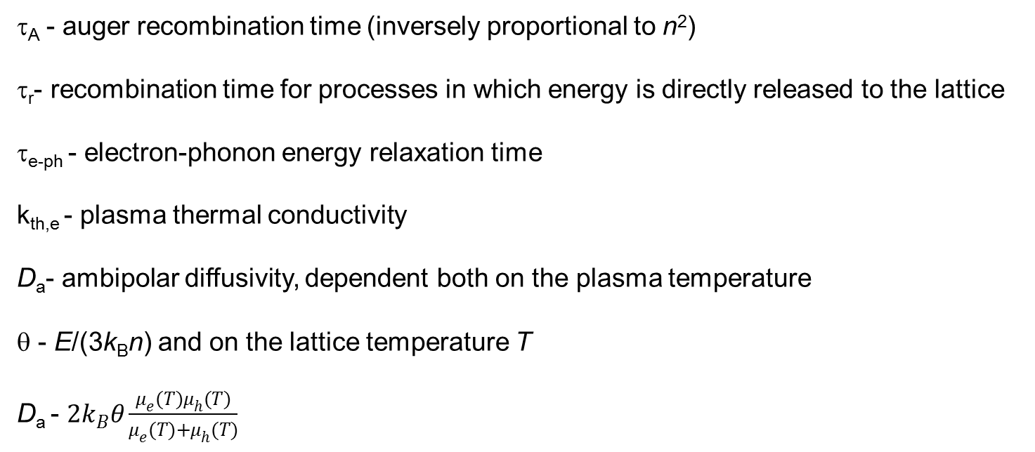
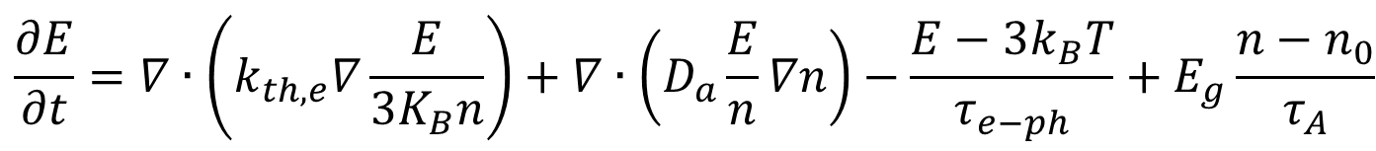
$$\frac{∂n}{∂t}=∇∙D_{a}∇n−\frac{n−n_{0}}{τ_{A}}−\frac{n−n_{0}}{τ_{r}}$$
$${\frac{∂E}{∂t}=∇∙\left(k_{th,e}∇\frac{E}{3K_{B}n}\right)+∇∙\left(D_{a}\frac{E}{n}∇n\right)−\frac{E−3k_{B}T}{τ_{e−ph}}+E}_{g}\frac{n−n_{0}}{τ_{A}}$$
τ_{A} - auger recombination time (inversely proportional to n²)
τ_{r}- recombination time for processes in which energy is directly released to the lattice
τ_{e-ph} - electron-phonon energy relaxation time
k_{th,e} - plasma thermal conductivity
D_{a}- ambipolar diffusivity, dependent both on the plasma temperature
θ - E/(3k_{B}n) and on the lattice temperature T
D_{a} - $2k_{B}θ\frac{μ_{e}(T)μ_{h}(T)}{μ_{e}(T)+μ_{h}(T)}$

Slide 16
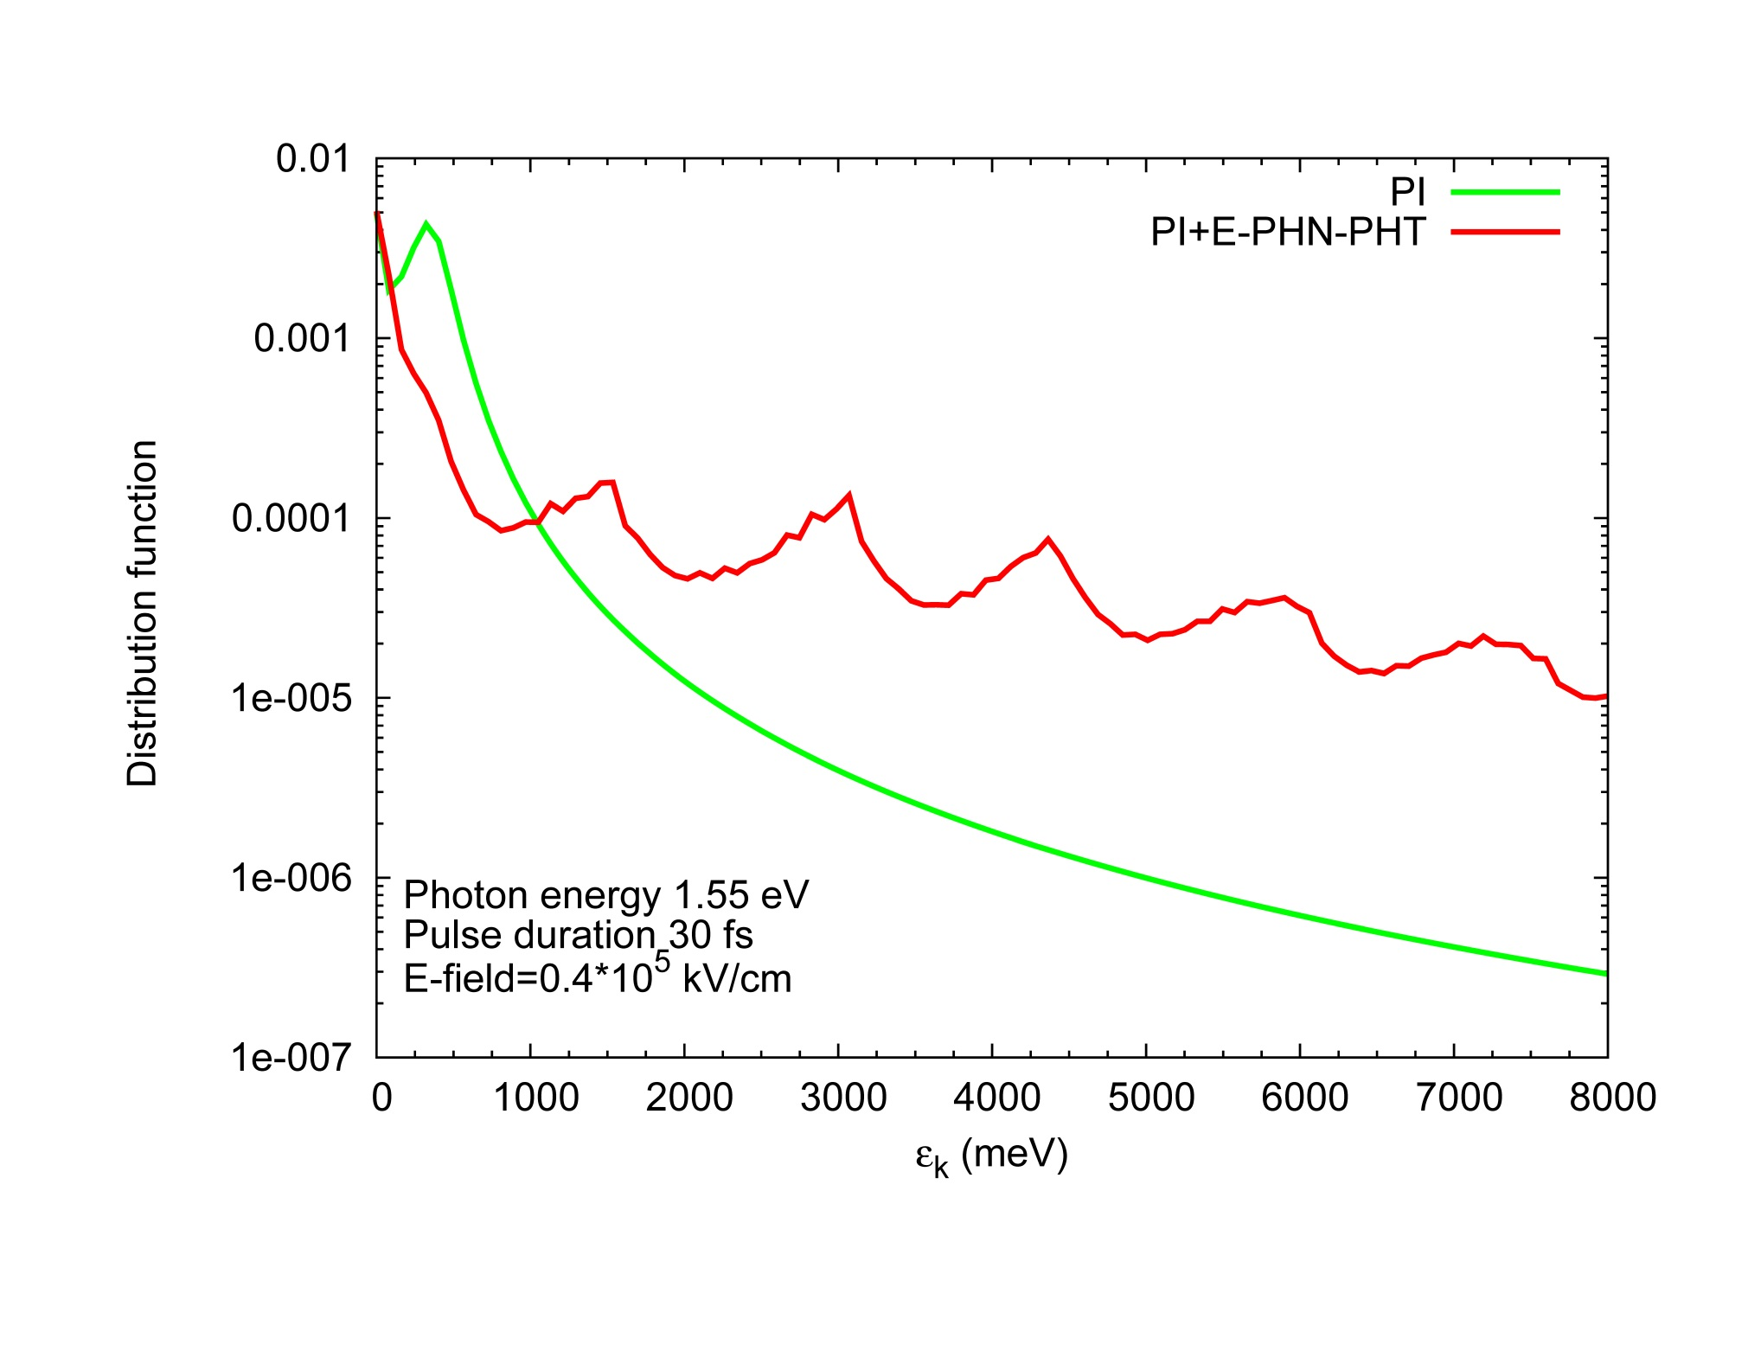
Results for CVD diamond

Slide 17
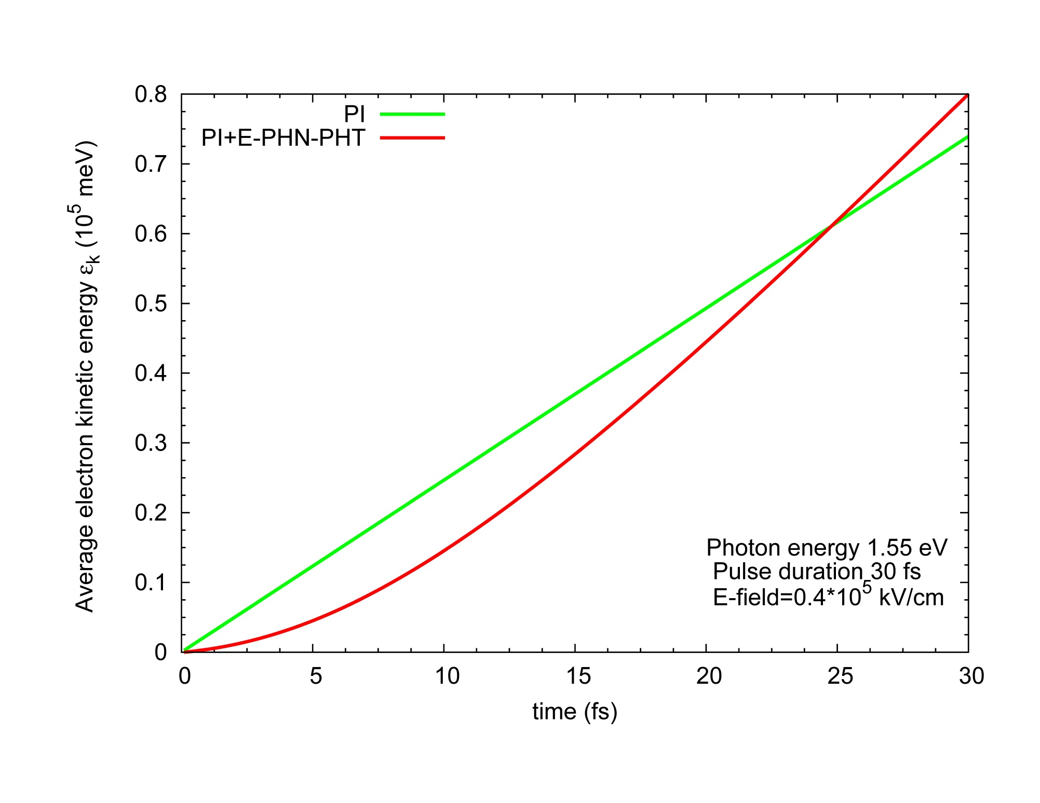
Results for CVD diamond

Slide 18
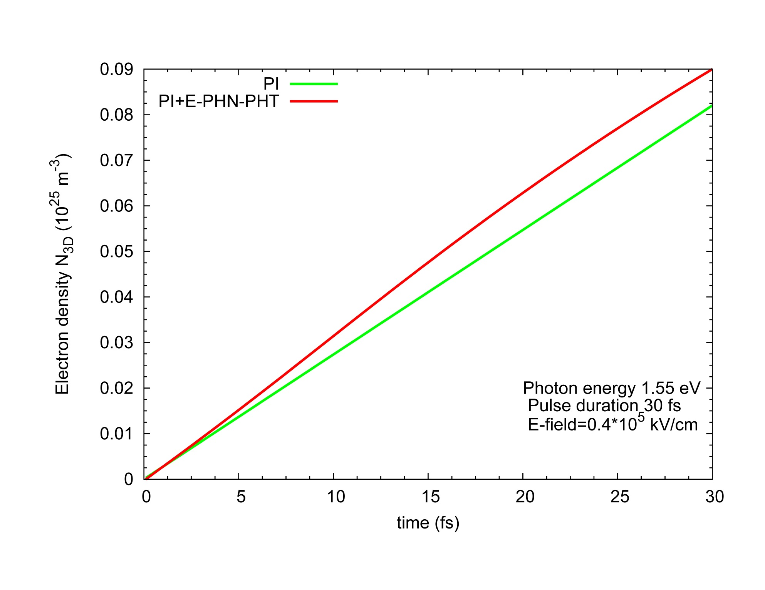
Results for CVD diamond

Slide 19
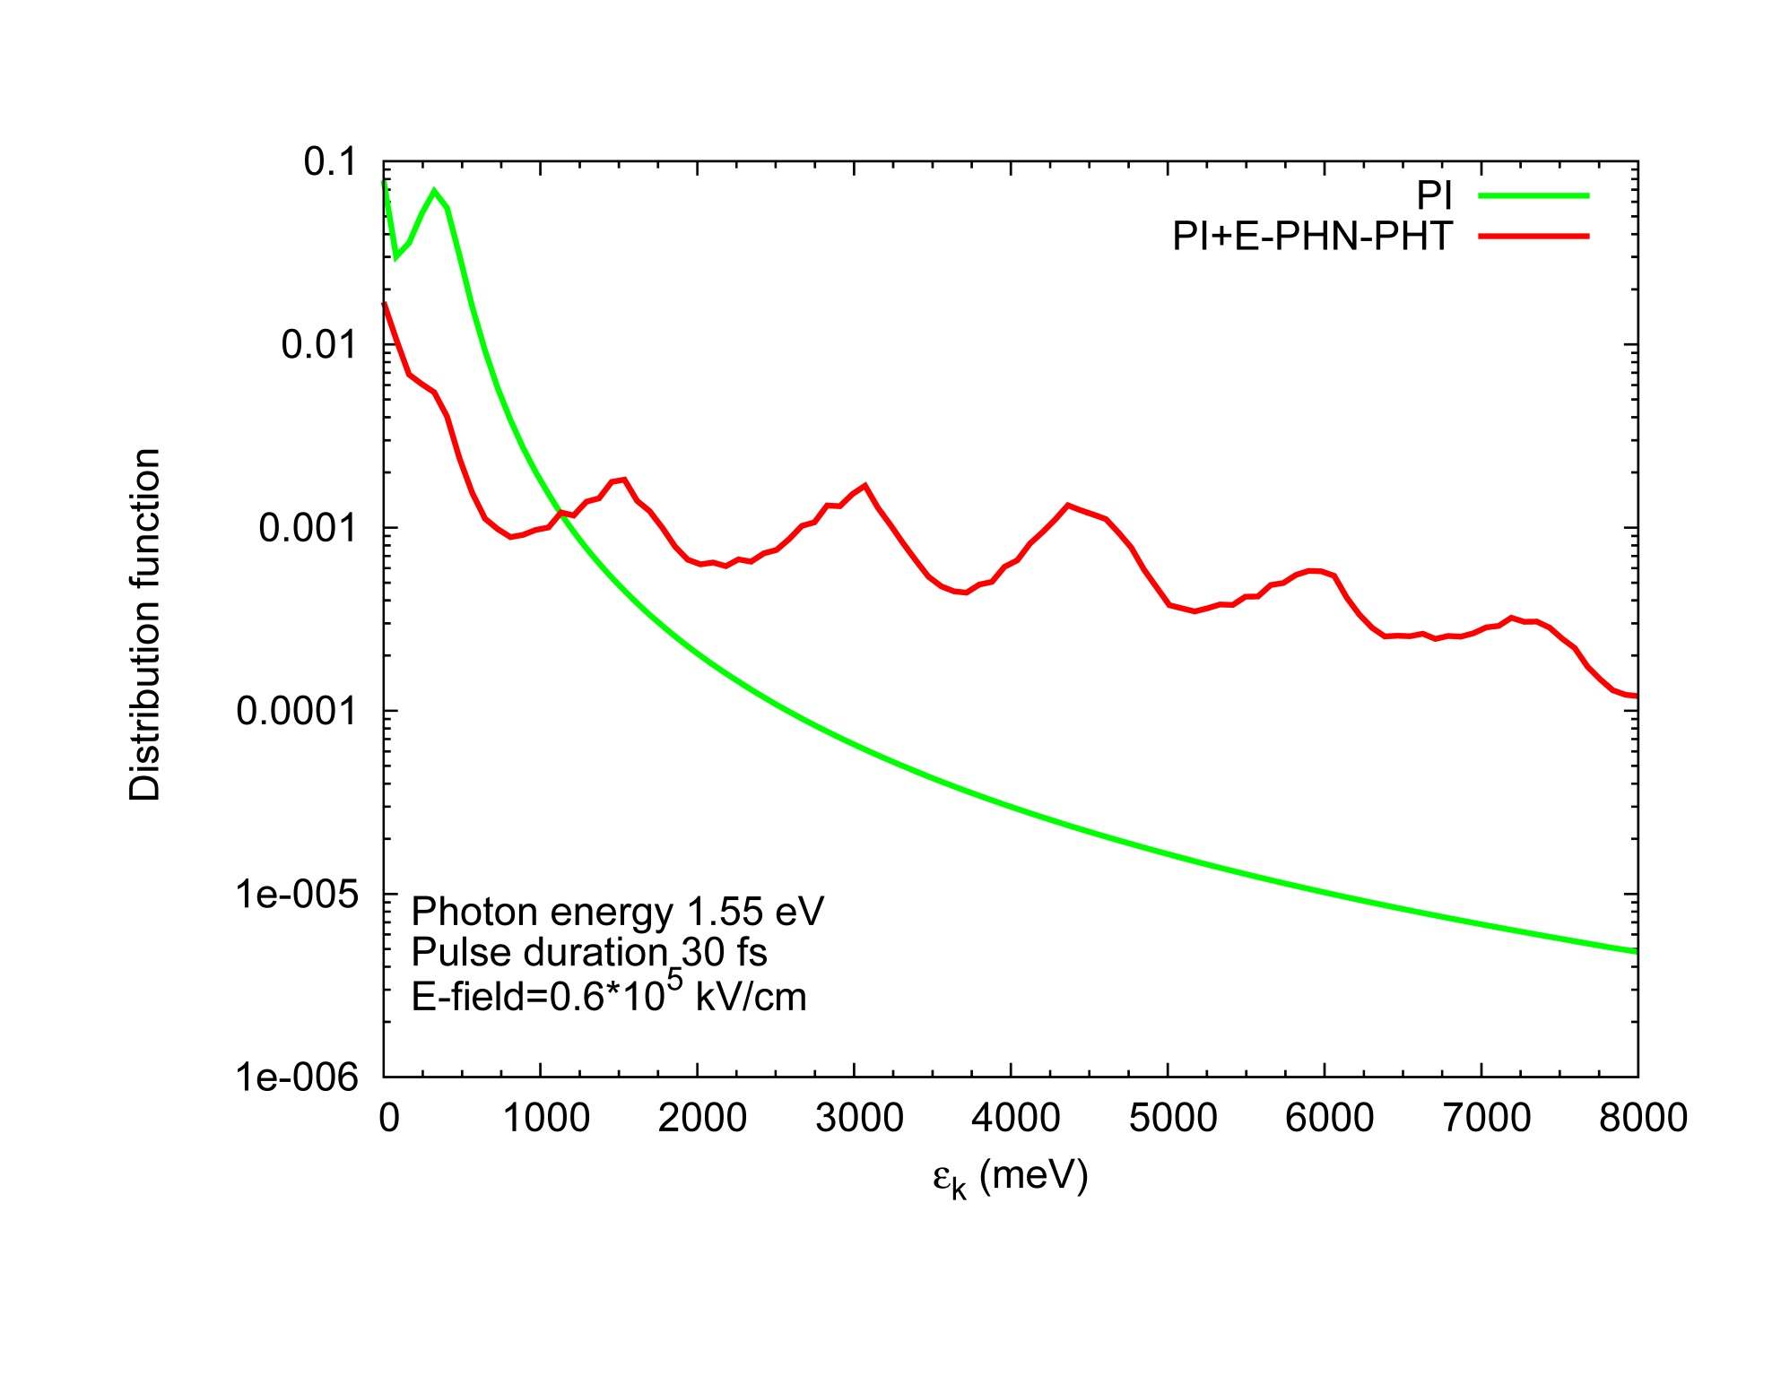
Results for CVD diamond

Slide 20
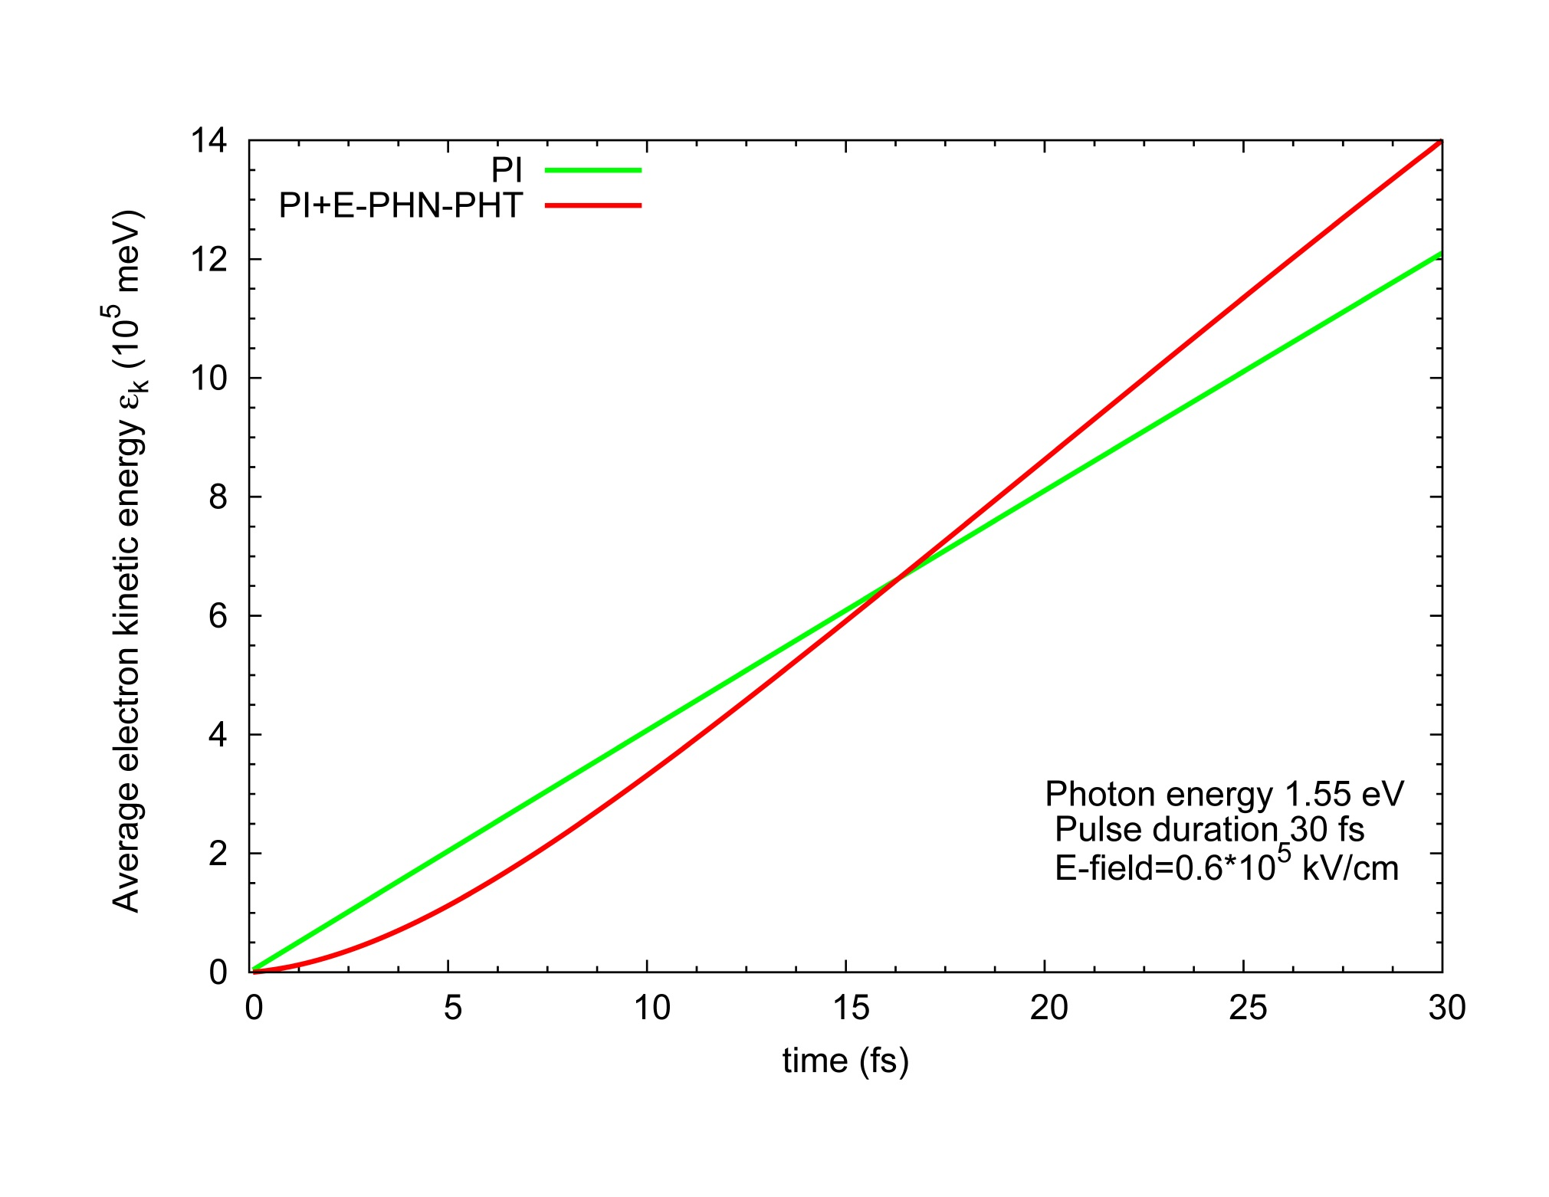
Results for CVD diamond

Slide 21
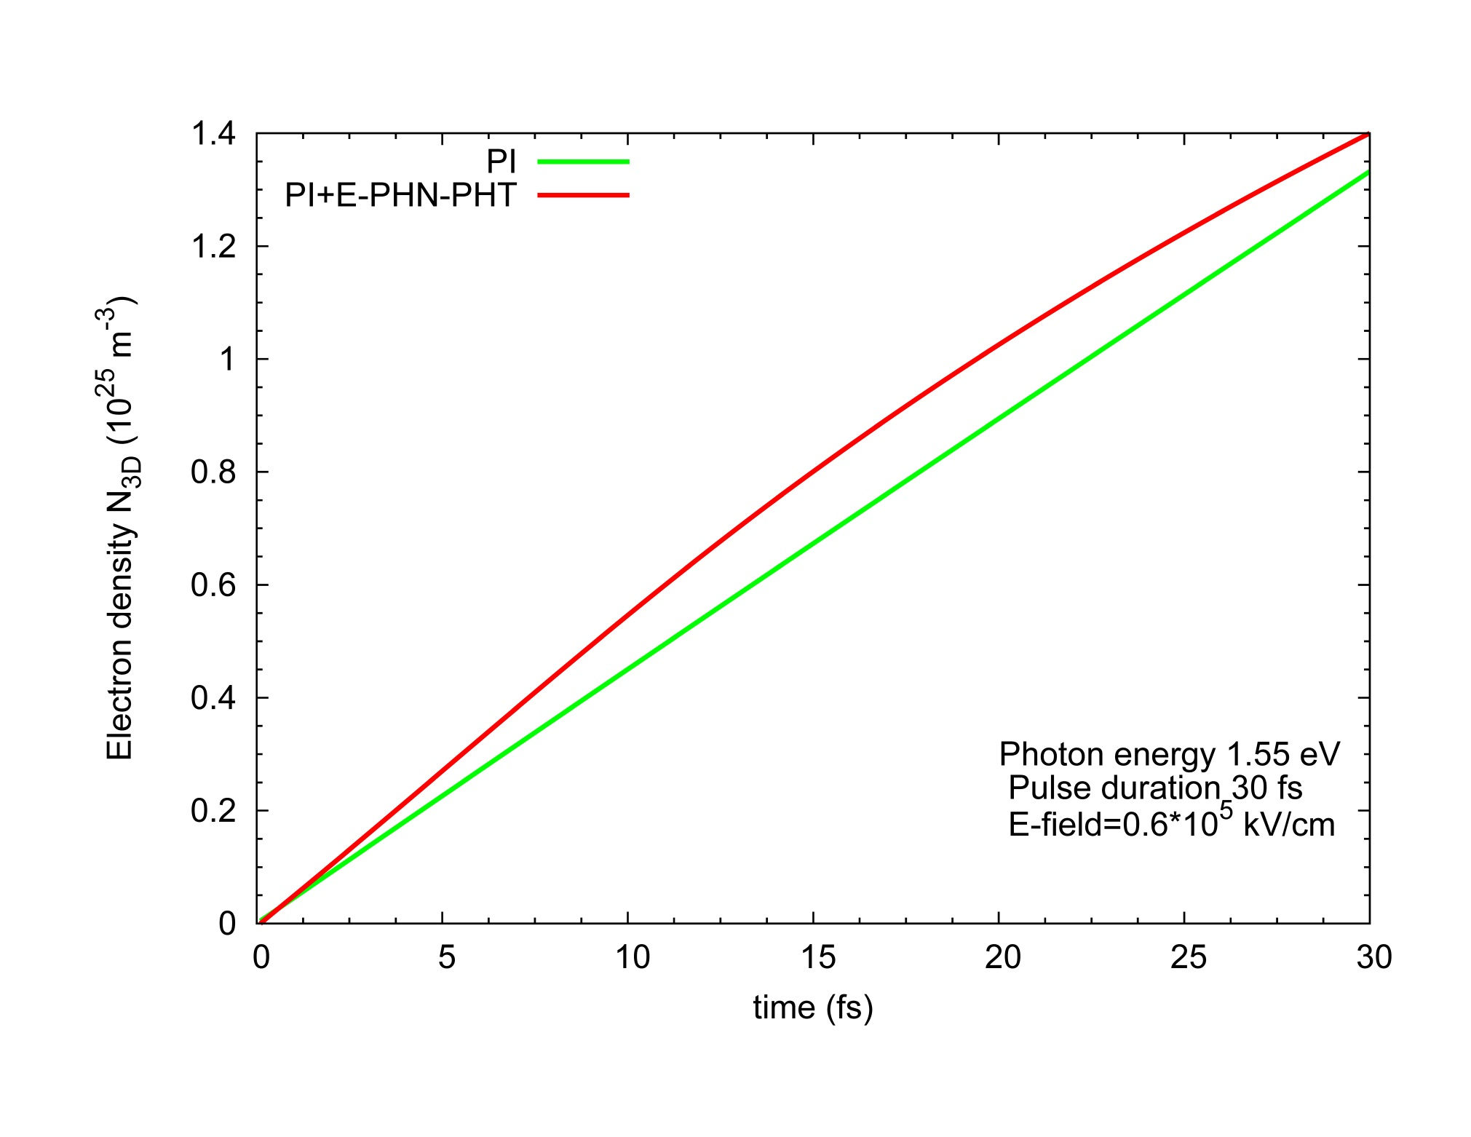
Results for CVD diamond

Slide 22
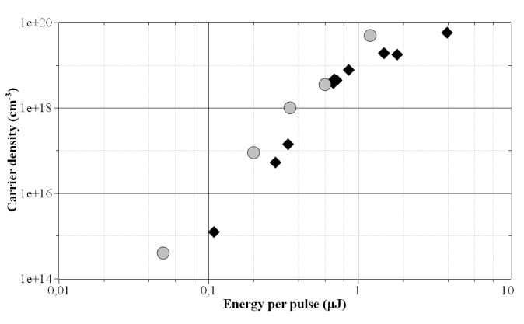
Results for CVD diamond

Slide 23
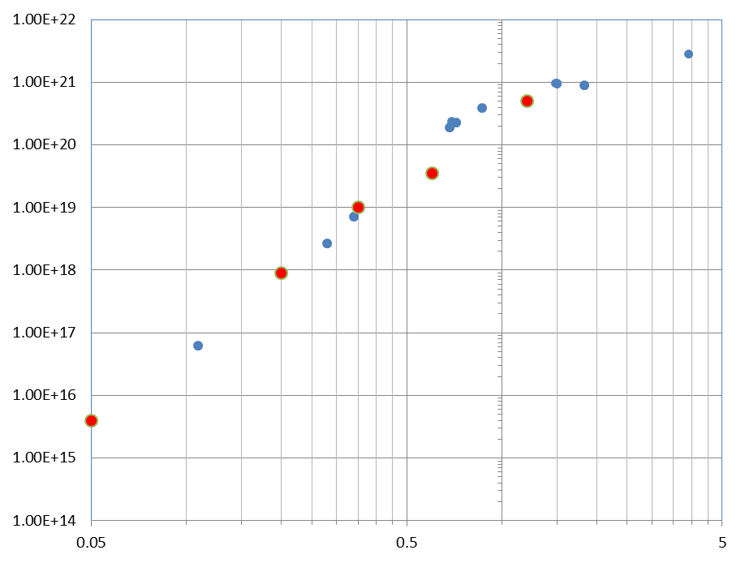
measurements
Log Q_{meas.} (a.u.)
Log n_{calc.}(a.u.)
model
μJ

Slide 24
Classification of laser damage to semiconductors and dielectrics
Optical damage
Electrical damage
Structural damage

Slide 25

Conclusions
A theoretical simulation accounting for the excitation processes in the bulk of diamond, induced by femtosecond laser irradiation has been carried out.
The input parameters correspond to the experimental conditions of fabrication of graphitic conductive channels, from low field intensity to below about the threshold of laser graphitization.
The model is in very good qualitative agreement with the experimental measurements of transient currents excited by the laser beam focused inside the diamond bulk.

Slide 26
Conclusions
An evaluation of the lattice temperature confirms the non-thermal nature of the graphitization process. A deeper understanding of the process will be useful to predict the outcome at different process parameters (wavelength, intensity, pulse width, repetition rate) and to plan useful improvements of the technology.

Slide 27
Outlook
More processes will be added to the calculation such as electron-electron scattering, electron-phonon scattering, impact ionization as well as non-radiative recombination for indirect band-gap materials.
The calculation will be extended to times after the end of the applied laser irradiation, i.e., tens and hundreds of picoseconds.

Slide 28
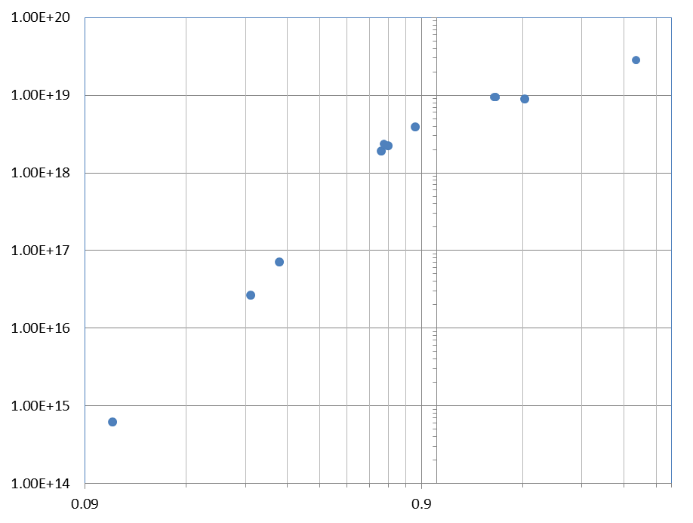
n (cm⁻³)
E (μJ)

Slide 29
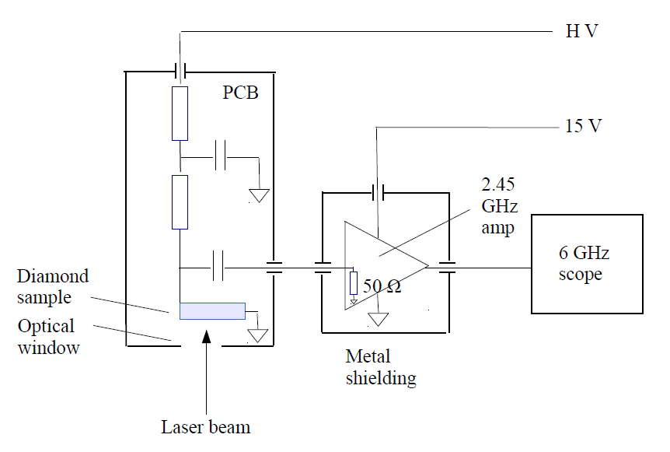
Our experimental approach:
The transient current technique (TCT) is used to measure laser induced current transients.

