Slide 1

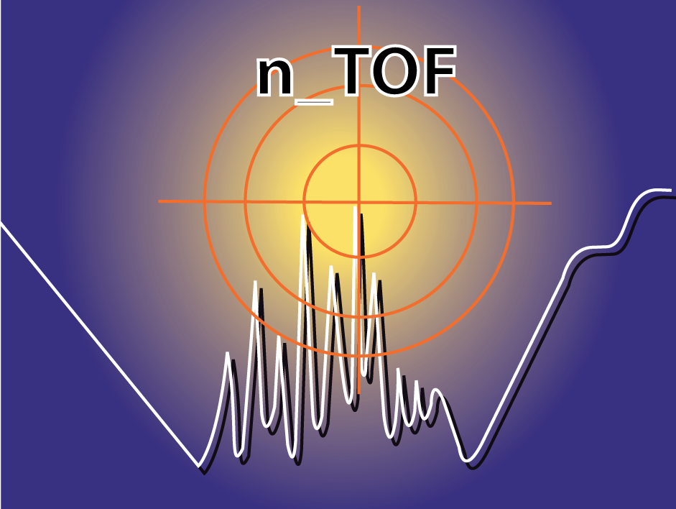


Spectroscopic Measurements with the Diamond Mosaic-Detector at n_TOF at CERN
ADAMAS Workshop
18. December 2012
Christina Weiss

Slide 2
Spectroscopic Measurements with the Diamond Mosaic-Detector at n_TOF at CERN
Outline
  The n_TOF Experiment at CERN
  The Measurement:
    ⁵⁹Ni Sample
    The Diamond Mosaic-Detector
    Setup at n_TOF
    Electronics
  Preliminary Results
  Conclusions

Slide 3
The n_TOF Experiment at CERN
Spectroscopic Measurements with the Diamond Mosaic-Detector at n_TOF at CERN

Slide 4
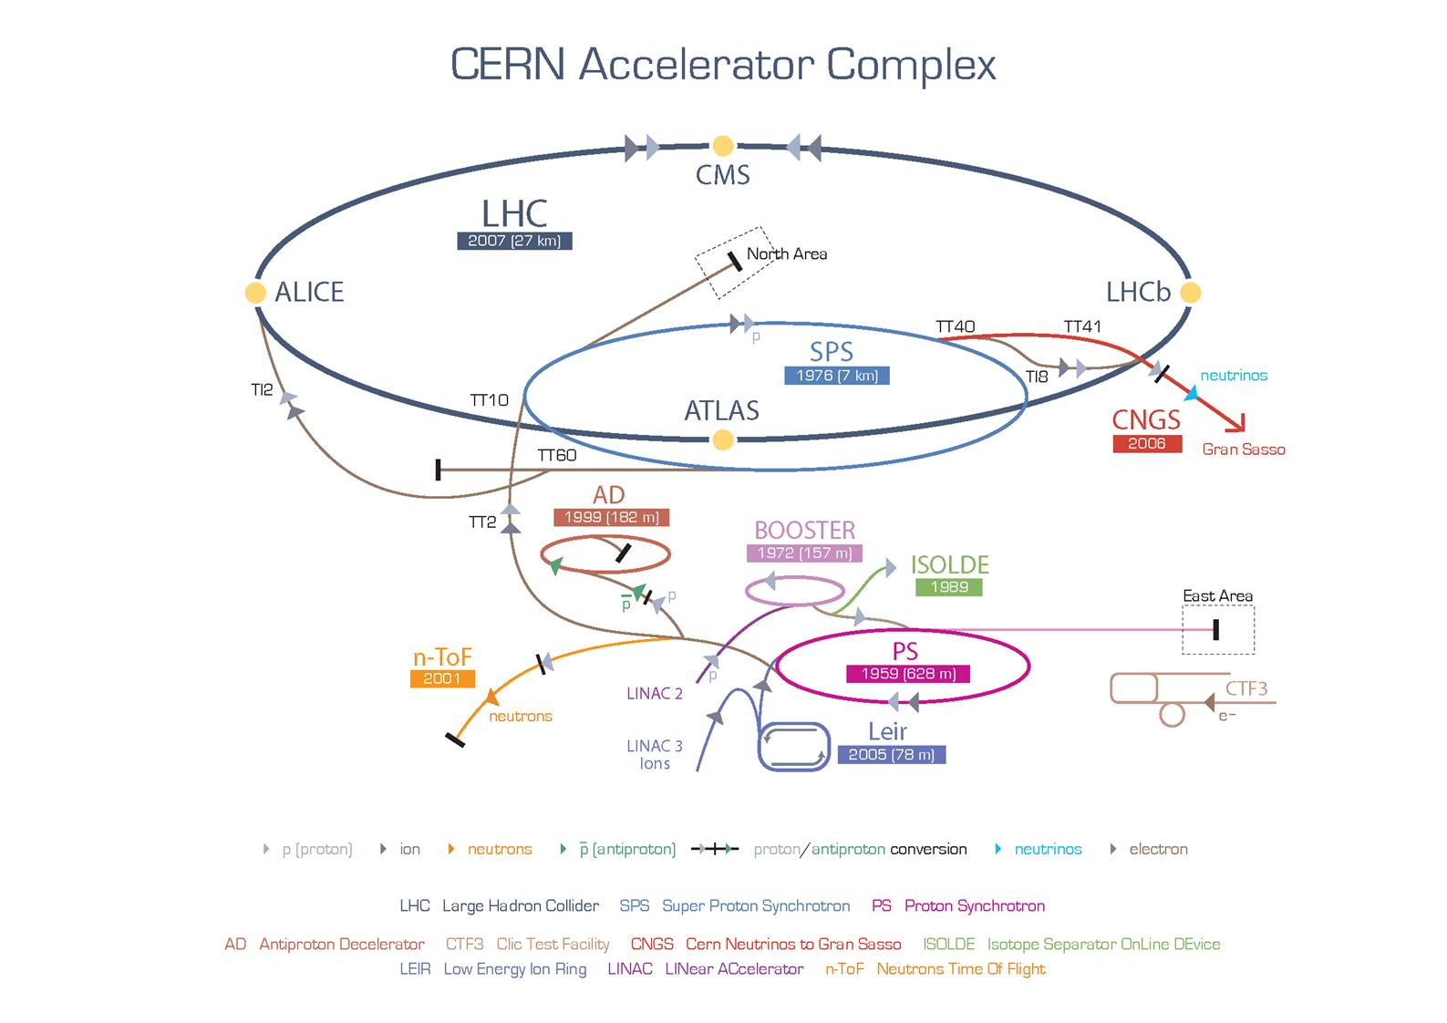
Spectroscopic Measurements with the Diamond Mosaic-Detector at n_TOF at CERN
The n_TOF Experiment at CERN

Slide 5
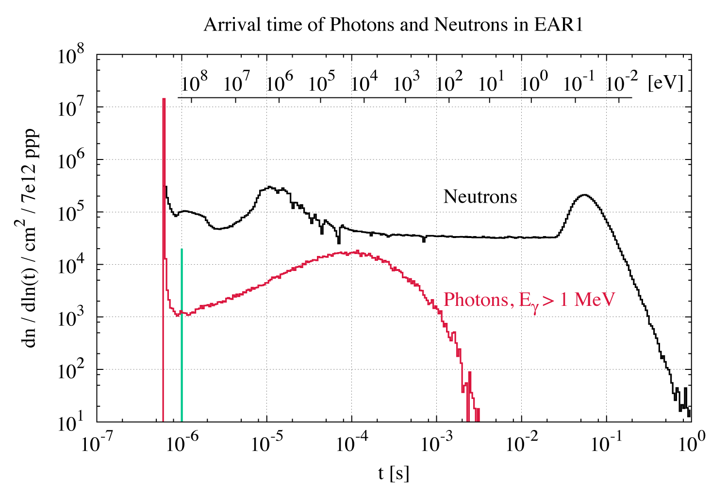
Spectroscopic Measurements with the Diamond Mosaic-Detector at n_TOF at CERN
The n_TOF Experiment at CERN
Neutron source: Spallation target
  20 GeV/c p on Pb target
Target surrounded with water moderator:
  Moderation of the neutrons => γ production
Beam at n_TOF:
  Promt photons = γ-flash
  Neutrons with GeV < E_{n} < thermal
  In-beam γ-background

Slide 6
Spectroscopic Measurements with the Diamond Mosaic-Detector at n_TOF at CERN
The n_TOF Experiment at CERN
n_TOF = neutron Time Of Flight
Reactions: (n,γ), (n,f), (n,α), …
Neutron and γ formation
Detection of:
Reaction products
in-beam γ−background
Trigger
γ−flash detection
Next Trigger
t_{PS}
t₀
t_{γ}
t_{n}
t_{PS}
Time
TOF
Data Aquisition

Slide 7
The MEasurement
Spectroscopic Measurements with the Diamond Mosaic-Detector at n_TOF at CERN

Slide 8
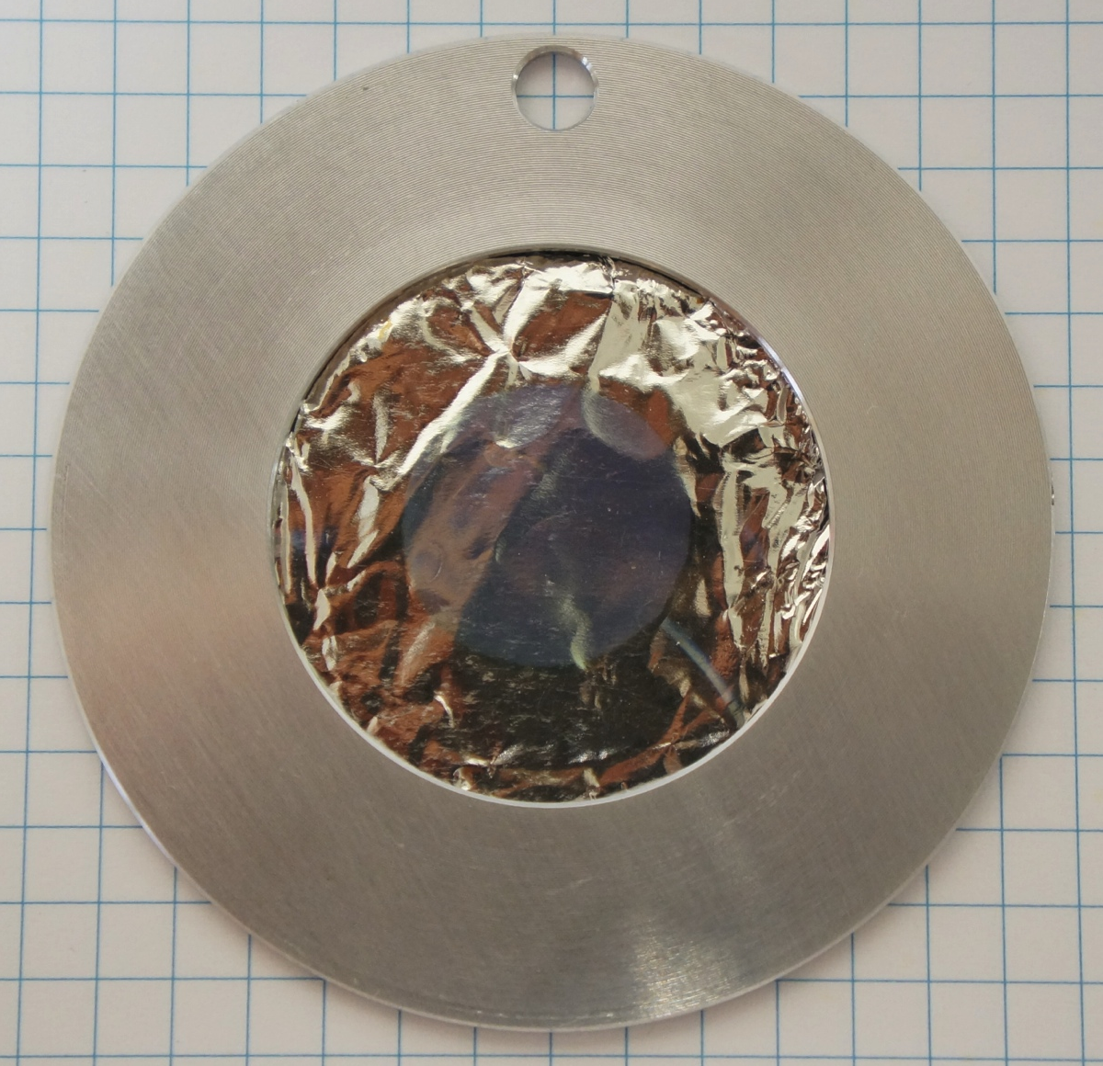
Spectroscopic Measurements with the Diamond Mosaic-Detector at n_TOF at CERN
⁵⁹Ni Sample
Radioactive Isotope ⁵⁹Ni:
  Decay via e—capture and β⁺, with t_{1/2} = 76.000 y
  Decay radiation: X-rays (E_{max} = 7.7 keV), Auger e⁻ (E_{max} = 6 keV), β⁺ (E_{max} = 25 keV)
Sample specifications:
  d = 1.5 cm
  (180 ± 5) μg metallic Ni (516 kBq): 95% ⁵⁹Ni: cross-section measurement
    thickness = 102 nm
  (205 ± 5) μg LiF: 95% ⁶Li: neutron fluence measurement = Beam Interception Factor (BIF)
    thickness = 394 nm
  electro-plated on 25 μm Pt foil
Reactions and products (emitted in 4π):
Reaction | Particle | E_{max} [MeV]
⁵⁹Ni(n,α)⁵⁶Fe | α | 4.76
⁵⁹Ni(n,p)⁵⁹Co | p | 1.82
⁶Li(n,α)³H | α | 2.06
⁶Li(n,α)³H | t | 2.73
Expected
Spectra

Slide 9
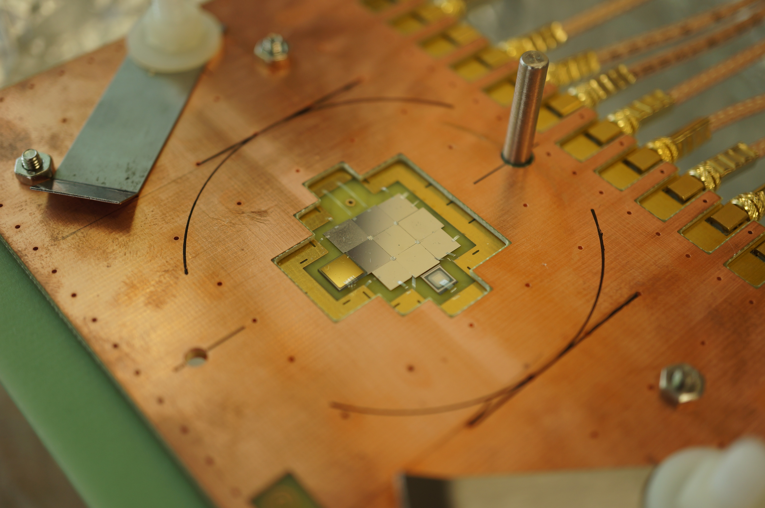
Spectroscopic Measurements with the Diamond Mosaic-Detector at n_TOF at CERN
The Diamond Mosaic-Detector¹⁾
8 sCVD + 1 DOI diamond diodes:
  Thickness: 150 μm
  Electrodes: 200 nm Al
  (in addition: 500 μm sCVD diamond diode and
  Si diode for background measurements)
  Materials:
  Diodes: C, Si, B, P
  Electrodes: Al, Au, Pt, C
Glued and bonded to PCB structure:
  Materials:
  PCB: epoxy resin, Cu, Au, Ni
  Bonding: Staystick thermoplastic, Al
Sample fixed on the PCB structure:
  => 1.85 mm maximum distance between sample and detector

Slide 10
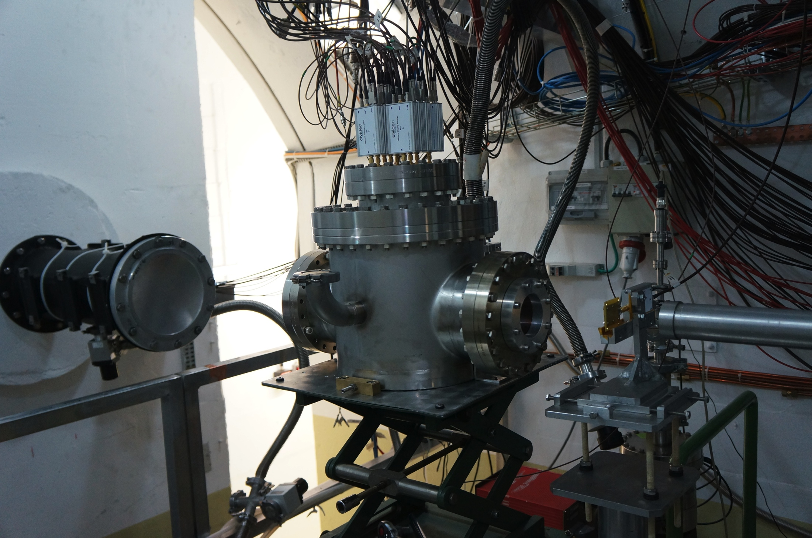
Spectroscopic Measurements with the Diamond Mosaic-Detector at n_TOF at CERN
Setup at n_TOF
Dedicated electronics¹⁾
Measurement under vacuum:
  p_{min} = 5×10⁻⁶ mbar
⁵⁹Ni run 15.10. – 9.11.2012:
  Sample out
  Pt backing
  ⁵⁹Ni + ⁶Li sample
  Beam off
  Calibration with 4-α source
Protons in total: 1.57×10¹⁸
= 4 weeks
Spectroscopic amplifiers
Neutrons
Vacuum Chamber

Slide 11
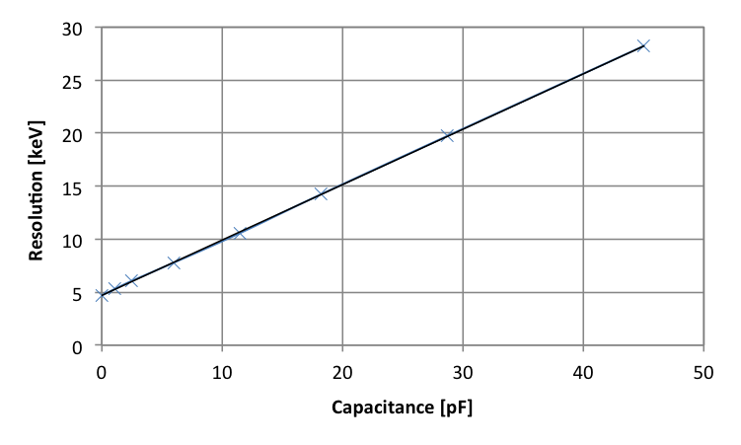
Spectroscopic Measurements with the Diamond Mosaic-Detector at n_TOF at CERN
    Electronics
CIVIDEC Cx Shaping Amplifier¹⁾:
  180 ns shaping amplifiers
  Gain of 8 mV/fC
  SNR/MeV for the setup ≈ 40
  Resolution for the setup ≈ 25 keV

Slide 12
Preliminary results
Spectroscopic Measurements with the Diamond Mosaic-Detector at n_TOF at CERN

Slide 13
Spectroscopic Measurements with the Diamond Mosaic-Detector at n_TOF at CERN
Amplitude over Neutron Energy
Included in Analysis:
E_{n} < 50 keV
Dedicated threshold per diode
Online calibration
Ni α
Li t
Li α

Slide 14
Spectroscopic Measurements with the Diamond Mosaic-Detector at n_TOF at CERN
    Neutron Energy Spectrum without Amplitude cuts - Background
Different materials can be seen in the background spectra
=> Resonances can be used to calibrate TOF-Energy conversion
Pt resonances clearly visible
in Dummy and Ni runs
Au resonance clearly visible
in all spectra
Pt backing seems to enhance
detection efficiency of
in-beam γ-rays

Slide 15
Spectroscopic Measurements with the Diamond Mosaic-Detector at n_TOF at CERN
Amplitude Spectra - Resolution
Neutron Fluence Measurement
Cross section measurement

Slide 16
Spectroscopic Measurements with the Diamond Mosaic-Detector at n_TOF at CERN
Neutron Fluence = Beam Interception Factor
Measured via ⁶Li(n,α)t reaction => Anisotropy at higher energies => Low neutron energy region (up to 100 eV) for fluence measurement
Fluence in total = 46% of n_TOF Flux (DOI not in evaluation)
Check of the alignment:
  Diamond mosaic detector as seen
  from the neutrons, values given
  as % of total n_TOF flux:
3% | 6% | 4%
5% | 7% | 7%
? | 7% | 5%

Slide 17
Spectroscopic Measurements with the Diamond Mosaic-Detector at n_TOF at CERN
    Reaction Yield for ⁵⁹Ni
Resonance at 203 eV is clearly visible in the experimental data
Background-subtraction not clean yet
46% of n_TOF neutron fluence in yield calculation
P R E L I M I N A R Y

Slide 18
Spectroscopic Measurements with the Diamond Mosaic-Detector at n_TOF at CERN
    Gain Drift of the Diodes
Online-check for the gain drift via triton peak
Sudden positive gain shift in DIAM2 after 1 week
Small negative gain shift in 5 out of 8 diodes after 2 weeks
Small positive gain shift in 1 diode
No gain shift in 1 diode
DIAM | Shift [mV] | Shift [%]
1 | - 4 | - 1.7%
2 | + 54 | + 21%
3 | 0 | 0
4 | - 2 | - 0.8%
5 | - 6 | - 1.9%
6 | - 4 | - 1.3%
8 | - 4 | - 1.3%
9 | + 6 | + 2%

Slide 19
Spectroscopic Measurements with the Diamond Mosaic-Detector at n_TOF at CERN
    Ionization Energy in Diamond?!
Conversion from voltage to deposited energy:
E_{ion} theoretical value: 13.6 eV
BUT:
Calibration with 4α-source:
E_{ion} from calibration of the Cm peak ranges from: 11.5 eV ≤ E_{ion} ≤ 16.6 eV
E_{ion} depends on the energy of the α particle: E_{ion} = f(E_{α})

Slide 20
Conclusions
Spectroscopic Measurements with the Diamond Mosaic-Detector at n_TOF at CERN

Slide 21
Spectroscopic Measurements with the Diamond Mosaic-Detector at n_TOF at CERN
    Conclusions
Stable, high-resolution spectroscopic cross-section measurement with focus on ⁵⁹Ni(n,α) cross-section (choice of sample)
Detector is suited for “high Q-value” (n,α) cross-section measurements
Less material in the beam would be profitable, but large area spectroscopic grade diamond would be needed for such a detector
Open questions:
    Gain shift
    Calibration

Slide 22
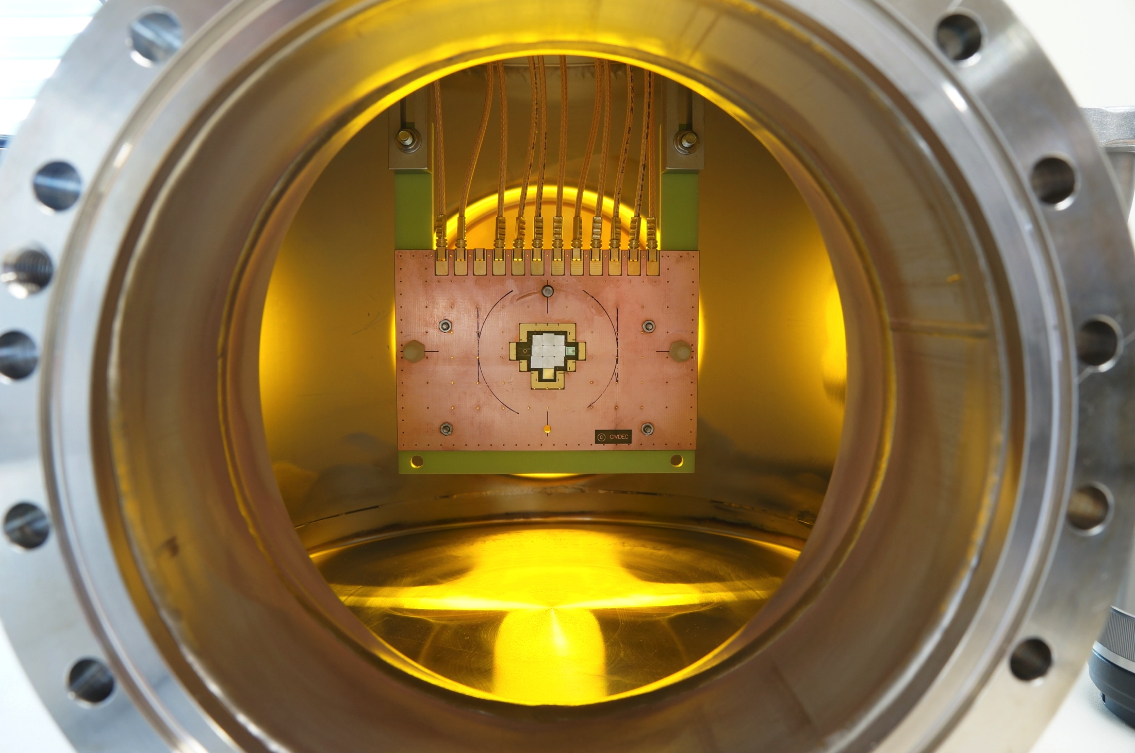
Acknowledgements
E. Griesmayer, C. Guerrero,
J. Andrzejewski, E. Berthoumieux, C. Chery, E. Chiaveri,
G. Ehrlich-Joop, D. Grenier, B. Hallgren, F. Käppeler, P. Koehler, I. McGill, A. Mongelluzzo,
H. Pernegger, J. Perkowski, M. Pomorski, P. Riedler, M. Schreck, L. Tassan-Got, A. Tsinganis
The n_TOF Collaboration, CIVIDEC Instrumentation GmbH

